Slide 1
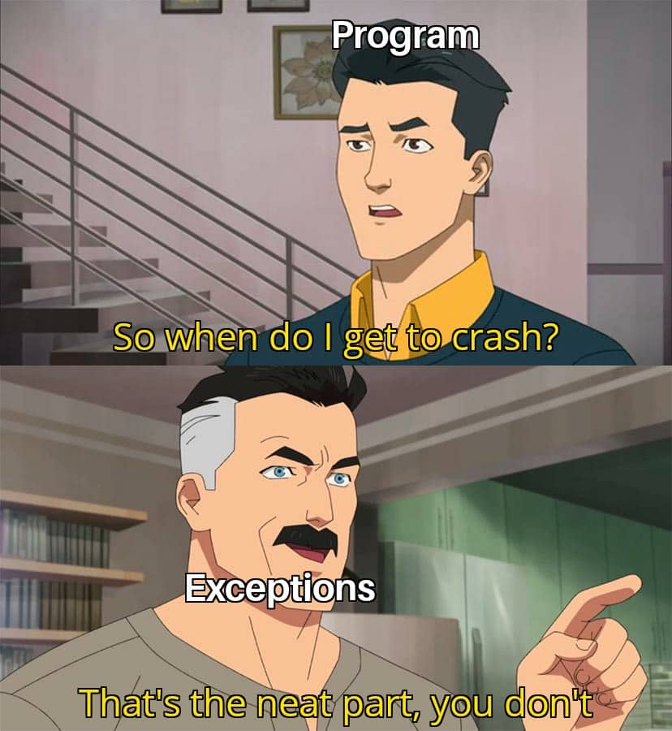
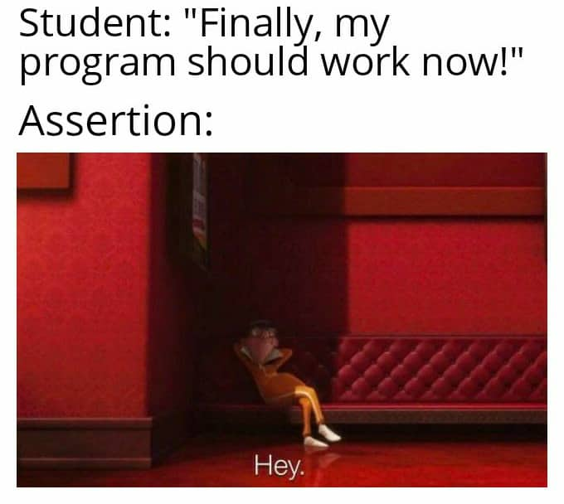
Week 9 Exceptions and Assertions
Raising Exceptions Assertions

Slide 2

Raising Exceptions
In python, you can create “user-defined” exceptions:
Recall the try and except statements from week 5. Using these in combination the your own exceptions will let you “handle errors more gracefully instead of letting the entire program crash.”
Call to the Exception() function
String with a helpful message (passed to the Exception() function)
The raise keyword

Slide 3
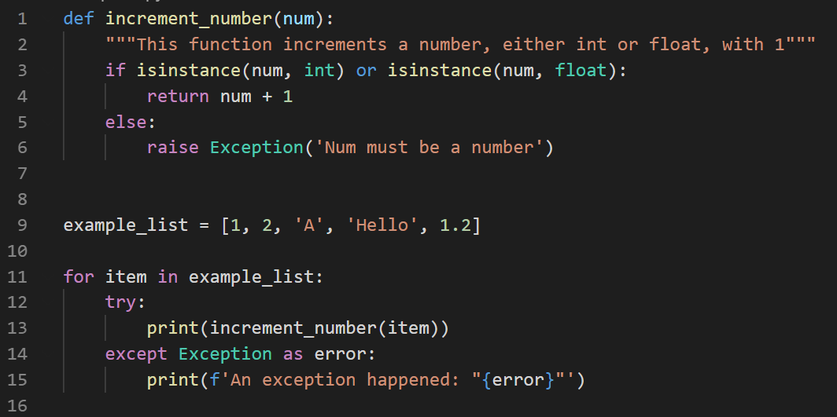
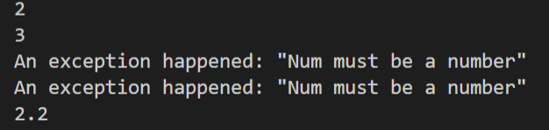
Example use in Function
If num is an integer or a float, return num + 1
Otherwise raise an Exception
Define list of example items
Try to print the return value of the function call with the given item
Loop through examples
If we hit an exception in the function call, save the exception in the “error” variable
Output

Slide 4
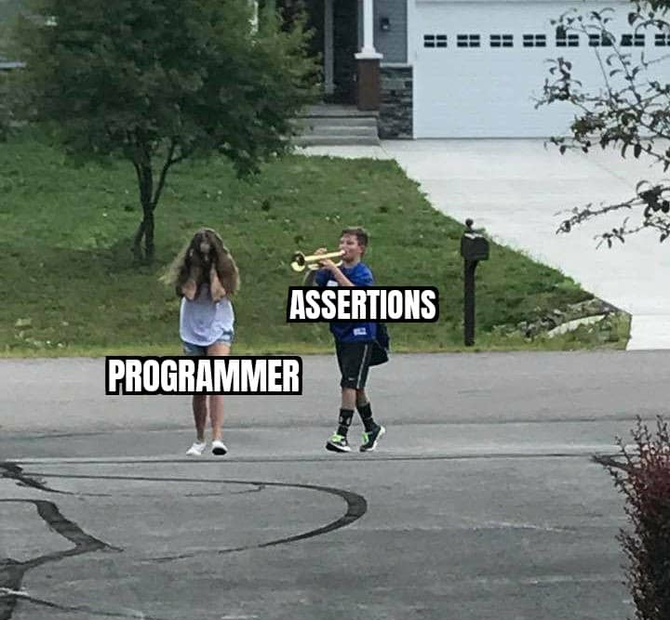
Assertions
While exceptions will fail quietly, Assertions will stop your program.
Assert statements check whether a condition is true.
If the condition evaluates to True, the program will keep running.
If the condition evaluates to False, the program will return an AssertionError and stop running.
A condition
comma
String that is displayed when the condition is False
The assert keyword

Slide 5
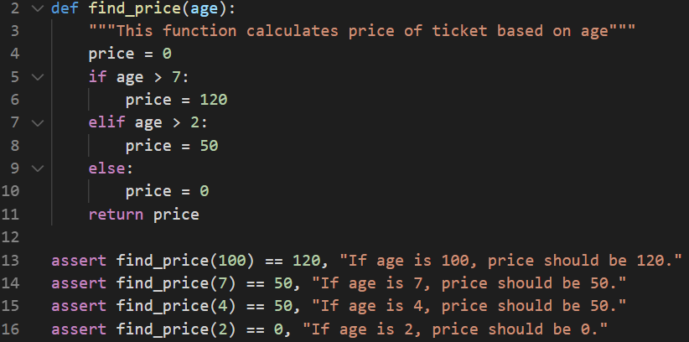
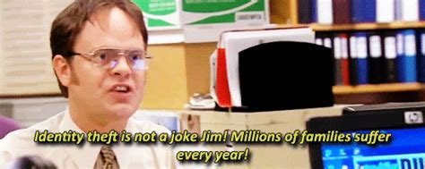
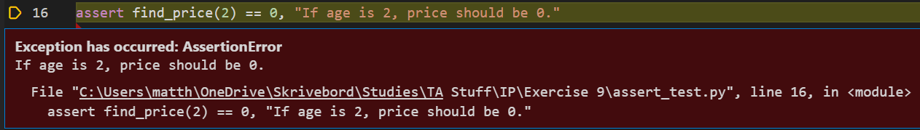
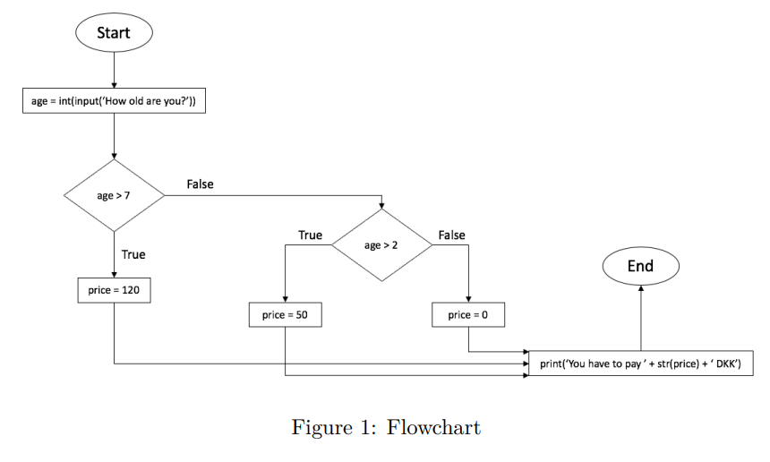
Example assertion task you might see in the exam
Write 4 assert statements that test whether the output of the function is as intended.

